Slide 1
Similarity
Geometry
Chapter 8

Slide 2
This Slideshow was developed to accompany the textbook
  Big Ideas Geometry
  By Larson and Boswell
  2022 K12 (National Geographic/Cengage)
Some examples and diagrams are taken from the textbook.
Slides created by
Richard Wright, Andrews Academy
rwright@andrews.edu

Slide 3
How to Solve Proportions and Solve Geometry Proportions using given equations

Slide 4
8.1 Similar Polygons
After this lesson…
• I can use similarity statements.
• I can fi nd corresponding lengths in similar polygons.
• I can fi nd perimeters and areas of similar polygons.
• I can decide whether polygons are similar.

Slide 5
8.1 Similar Polygons
When I show the same thing on the overhead projector and the computer monitor, the projected image is larger than what is on the screen. The image is of a different size, but the same shape as what I write. They are similar.
Notes:
Have the overhead ready

Slide 6
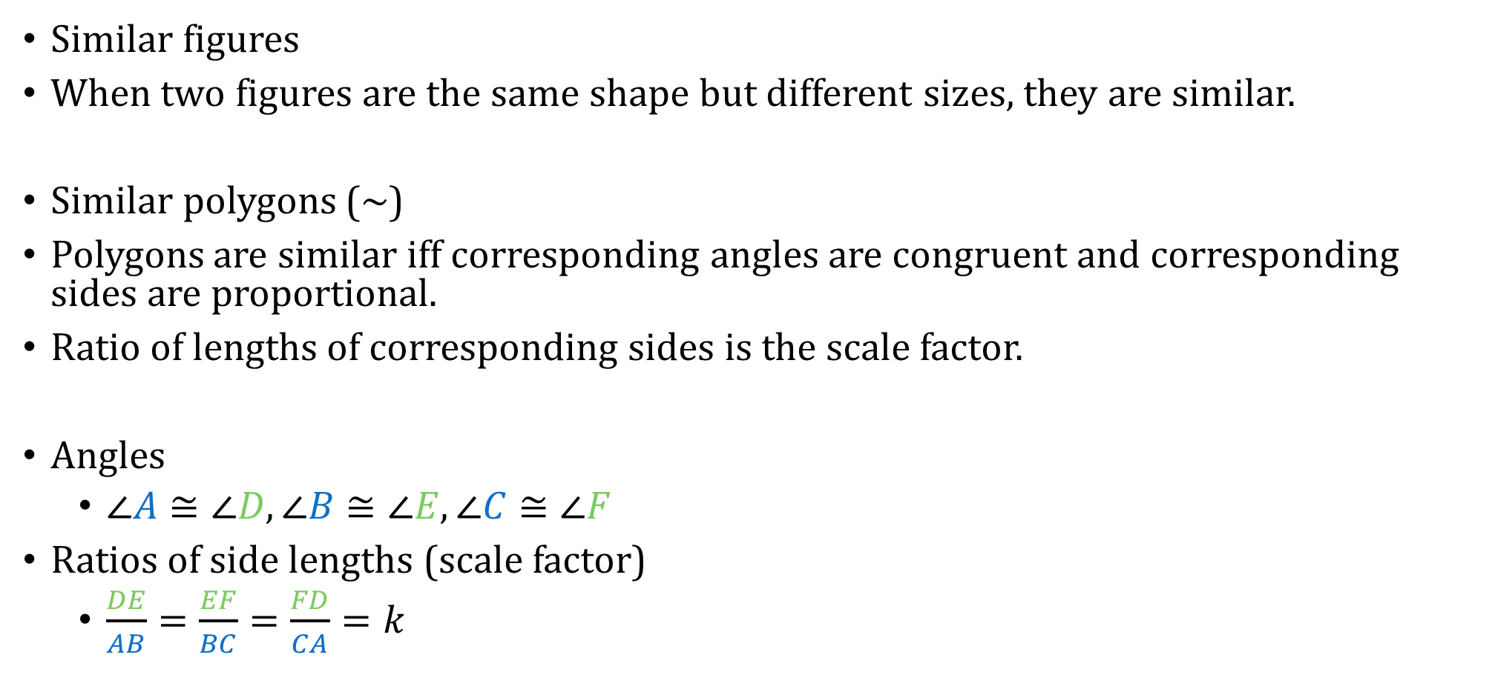

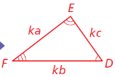
8.1 Similar Polygons

Slide 7
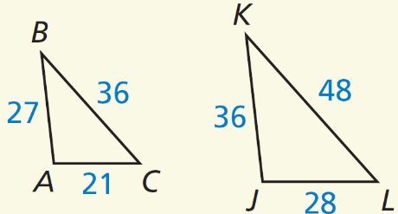
8.1 Similar Polygons
△ABC ∼ △JKL
Find the scale factor from △ABC to △JKL.
List all pairs of congruent angles.
Write the ratios of the corresponding side lengths in a statement of proportionality.
Try #2
Notes:
𝐽𝐾/𝐴𝐵=36/27=4/3
∠𝐴 ≅ ∠𝐽, ∠𝐵 ≅ ∠𝐾, ∠𝐶 ≅ ∠𝐿
𝐽𝐾/𝐴𝐵=𝐾𝐿/𝐵𝐶=𝐿𝐽/𝐶𝐴

Slide 8
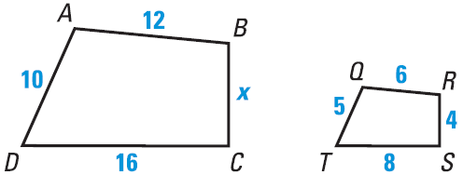
8.1 Similar Polygons
ABCD ~ QRST
What is the scale factor of QRST to ABCD?
Find x.
Try #4
Notes:
Scale factor: 6/12=1/2
x: 1/2=4/𝑥 → x = 8

Slide 9
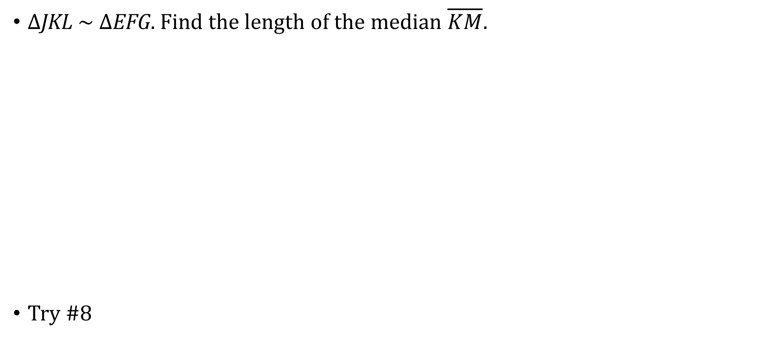
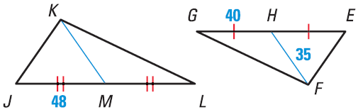
8.1 Similar Polygons
Notes:
48/40=𝐾𝑀/35
40⋅𝐾𝑀=48⋅35
40⋅𝐾𝑀=1680
𝐾𝑀=42

Slide 10
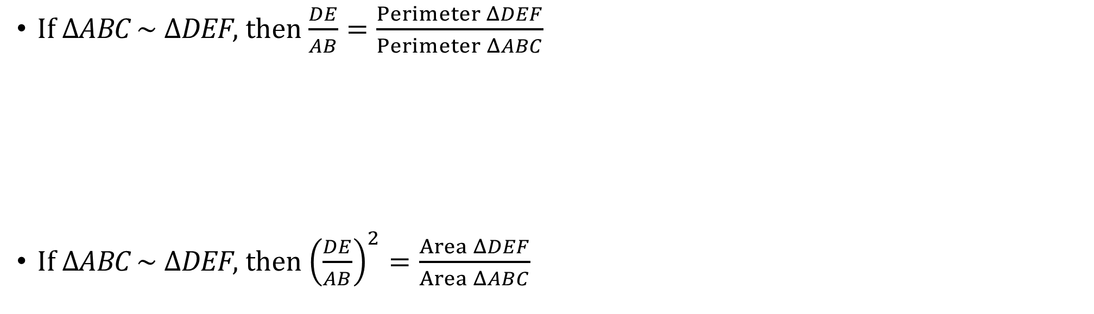
8.1 Similar Polygons
Perimeters of Similar Polygons
If two polygons are similar, then the ratio of their perimeters is equal to the ratios of their corresponding side lengths.
Area of Similar Polygons
If two polygons are similar, then the ratio of their areas is equal to the squares of the ratios of their corresponding side lengths.

Slide 11
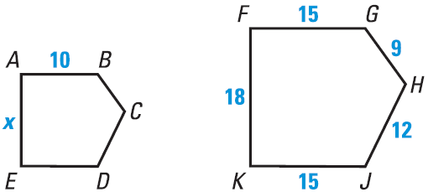
8.1 Similar Polygons
ABCDE ~ FGHJK, the area of FGHJK is 318 in²
Find the scale factor of FGHJK to ABCDE
Find the perimeter of ABCDE
Find the area of ABCDE
Try #18
Notes:
Scale factor: 15/10=3/2
x: 3/2=18/𝑥 → 3𝑥=36 → 𝑥=12
Perimeter: 3/2=(15+9+12+15+18)/𝑃 → 3/2=69/𝑃 → 3𝑃=138 → P = 46

Slide 12
8.2 Proving Triangle Similarity by AA
After this lesson…
• I can use similarity transformations to prove the Angle-Angle Similarity Theorem.
• I can use angle measures of triangles to determine whether triangles are similar.
• I can solve real-life problems using similar triangles.

Slide 13
8.2 Proving Triangle Similarity by AA
Draw two triangles with two pairs of congruent angles. Measure the corresponding sides. Are they proportional? Are the triangles similar?
55°
34°
55°
34°
AA Similarity
If two angles of one triangle are congruent to two angles of another triangle, then the triangles are similar.

Slide 14
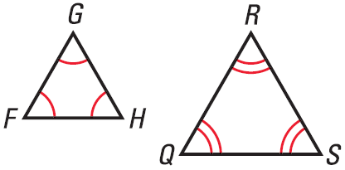
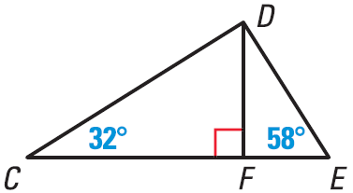
8.2 Proving Triangle Similarity by AA
Show that the triangles are similar. Write a similarity statement.
Try #2
Notes:
ΔFGH ~ ΔQRS by AA Similarity
m∠CDF = 58 by Triangle Sum Theorem
ΔCDF ~ ΔDEF by AA Similarity

Slide 15
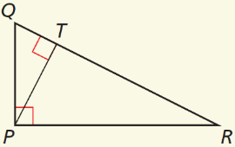
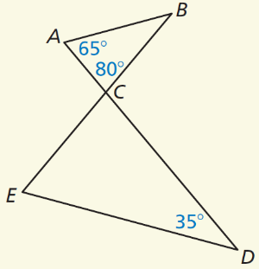
8.2 Proving Triangle Similarity by AA
Show that the triangles are similar. Write a similarity statement.
△QPR and △QTP
△ABC and △EDC
Try #6
Notes:
∠Q ≅ ∠Q by the Reflexive Property of Angle Congruence. ∠QPR ≅ ∠QTP by the Right Angles Congruence Theorem. So, △QPR ∼ △QTP by the AA Similarity Theorem.
∠ACB ≅ ∠ECD by the Vertical Angles Congruence Theorem. m∠B = 35° by the Triangle Sum Theorem. Because m∠B and m∠D both equal 35°, ∠B ≅ ∠D. So, △ABC ∼ △EDC by the AA Similarity Theorem.

Slide 16
8.2 Proving Triangle Similarity by AA
You can use similar triangles to find things like the height of a tree by using shadows. You put a stick perpendicular to the ground. Measure the stick and the shadow. Then measure the shadow of the tree. The triangles formed by the stick and the shadow and the tree and its shadow are similar so the height of the tree can be found by ratios. Suppose we use a meter stick. The stick’s shadow is 3 m. The tree’s shadow is 150 m. How high is the tree?
Try #20
Notes:
"Tree Shadow" /"Stick Shadow" ="Tree Height" /"Stick Height"
150/3=𝑥/1
𝑥=50 𝑚

Slide 17
8.3 Proving Triangle Similarity by SSS and SAS
After this lesson…
• I can use the SSS and SAS Similarity Theorems to determine whether
triangles are similar.

Slide 18
8.3 Proving Triangle Similarity by SSS and SAS
SSS Similarity
If the measures of the corresponding sides of two triangles are proportional, then the triangles are similar.
SAS Similarity
If the measures of two sides of a triangle are proportional to the measures of two corresponding sides of another triangle and the included angles are congruent, then the triangles are similar.
Notes:
SSS Similarity - That’s what happens when you enlarge a drawing.

Slide 19
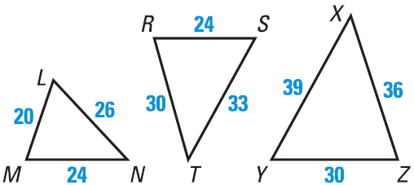
8.3 Proving Triangle Similarity by SSS and SAS
Which of the three triangles are similar?
Try #2
Notes:
Try ΔLMN and ΔRST: 20/24=24/30=26/33 This is not true.
Try ΔLMN and ΔXYZ: 20/30=24/36=26/39 This is true. ΔLMN ~ ΔYZX
Try ΔXYZ and ΔRST: 30/24=36/30=39/33 This is not true.
12/24=𝑥/30=𝑦/33
12/24=𝑥/30 → 24x = 360 → x = 15
12/24=𝑦/33 → 24y = 396 → x = 16.5

Slide 20
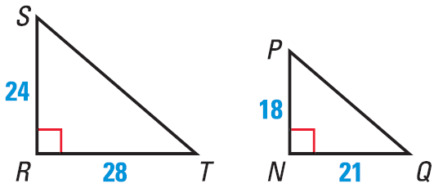
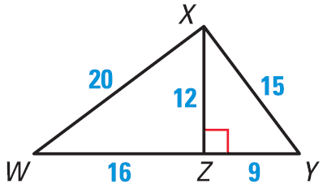
8.3 Proving Triangle Similarity by SSS and SAS
Explain how to show that the indicated triangles are similar.
ΔSRT ~ ΔPNQ
ΔXZW ~ ΔYZX
Try #9
Notes:
𝑅𝑆/𝑁𝑃=24/18=4/3;𝑅𝑇/𝑁𝑄=28/21=4/3;∠𝑅≅∠𝑁; SAS Similarity
𝑋𝑍/𝑌𝑍=12/9=4/3;𝑍𝑊/𝑍𝑋=16/12=4/3;𝑋𝑊/𝑌𝑋=20/15=4/3; SSS Similarity (or SAS Similarity)

Slide 21
8.4 Proportionality Theorems
After this lesson…
• I can use proportionality theorems to find lengths in triangles.
• I can find lengths when two transversals intersect three parallel lines.
• I can find lengths when a ray bisects an angle of a triangle.

Slide 22
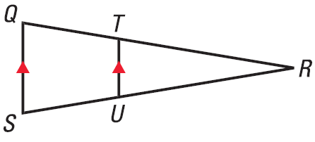
8.4 Proportionality Theorems
Triangle Proportionality Theorem
If a line is parallel to a side of a triangle, then it separates the other two sides into proportional segments.
And the converse is also true. Proportional segments → line parallel to the third side.

Slide 23
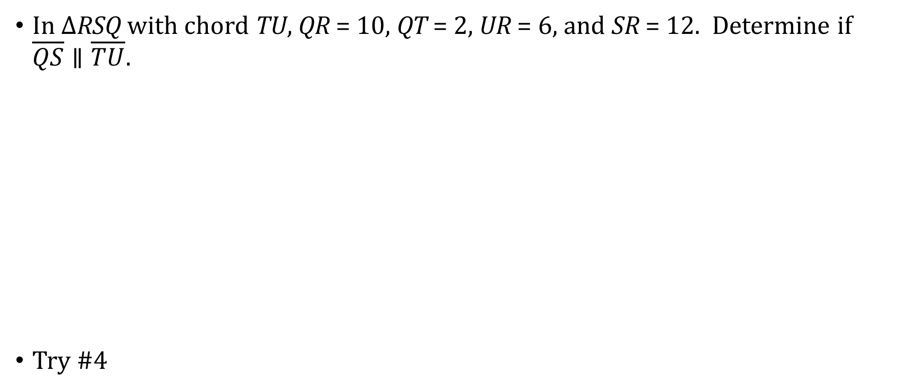
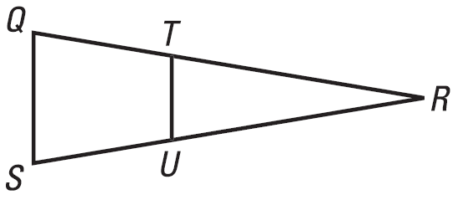
8.4 Proportionality Theorems
Notes:
𝑇𝑅 = 10−2=8, 𝑈𝑆=12−6=6
𝑇𝑅/𝑄𝑇=𝑅𝑈/𝑈𝑆 →8/2=6/6 → 4=1
False, not parallel

Slide 24
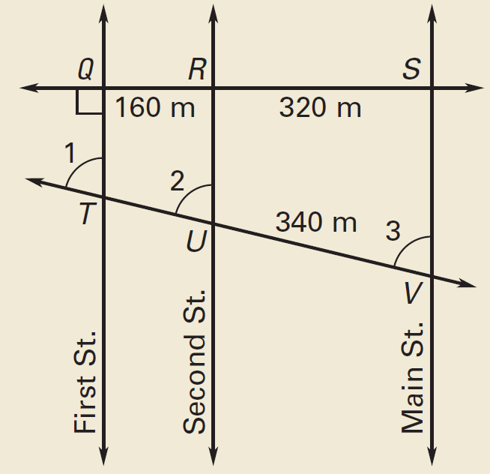
8.4 Proportionality Theorems
If three or more parallel lines intersect two transversals, then they cut off the transversals proportionally.
Using the information in the diagram, find the distance TV.
Try #12
Notes:
𝑇𝑈/340=160/320
320𝑇𝑈=54400
𝑇𝑈=170
𝑇𝑉=𝑇𝑈+𝑈𝑉=170+340=510 𝑚

Slide 25
8.4 Proportionality Theorems
An angle bisector in a triangle separates the opposite side into segments that have the same ratio as the other two sides.
Find x
Try #18
12
10
x
18
Notes:
10/𝑥=12/(18−𝑥) → 10(18−𝑥)=12𝑥 → 180−10𝑥=12𝑥 → 180=22𝑥 → 𝑥=180/22 =8.18

